Slide 1

The API Economy
The Next Trillion Dollar Software Wave
Fusing Serverless, AI, IoT, Blockchain, and Quantum Technologies in Next-Gen APIs
https://panacloud.github.io/bootcamp-2021/

Slide 2

What is an API?
An API (or “Application Programming Interface”) is a software intermediary for an application or service that enables other applications or services to send them requests and receive responses to those requests.
They allow different systems to talk to each other in a seamless, fast fashion.
This gives developers certainty when integrating systems and can also enable larger monolithic services to be broken down into smaller independent services with defined interfaces.
Notes:
https://www.torocloud.com/blog/what-is-the-API-economy-and-why-it-matters-to-your-business

Slide 3
What is Digital Transformation?
Digital transformation is the integration of digital technology into all areas of a business, fundamentally changing how you operate and deliver value to customers.
It's also a cultural change that requires organizations to continually challenge the status quo, experiment, and get comfortable with failure.
Notes:
https://enterprisersproject.com/what-is-digital-transformation

Slide 4
API the Key to Digital Transformation
The ability to innovate at an unprecedented rate is the key to succeeding in today’s fast-paced digital world.
In recent years, many businesses have realized APIs, that set clearly defined methods of communication among various software components, are an effective way to enable the digital transformation of their enterprise.
Notes:
https://www.torocloud.com/blog/what-is-the-API-economy-and-why-it-matters-to-your-business

Slide 5
APIs Role in Digital Transformation
Companies are finding it critical to have a digital-first strategy, where they can offer products and services through an omnichannel approach.
Omnichannel – is a multichannel approach to sales that seeks to provide customers with a seamless shopping experience, whether they're shopping online from a desktop or mobile device, by telephone, or in a brick-and-mortar store.
This starts with moving from on-prem to the cloud, where it's common to leverage multiple vendors.
This approach results in information federated across multiple providers/systems.
This is a huge problem because having a digital-first strategy requires access to real-time, relevant information across multiple systems and the mobility to execute business processes via multiple devices.
For this to work, APIs must be used to access separate systems and provide necessary connectivity.
Notes:
https://chrisgaertner.medium.com/the-future-is-api-first-5810584ff23

Slide 6
API Adoption is Exploding
Every future app will need an approach to Program the World, a way of connecting, accessing and controlling every digital and physical asset on the planet.
We must enable every form of digital asset to become programmable, transforming everything into an Application Programming Interface (API).
“The world is on course to having a trillion programmable endpoints,” said Tyler Jewell, the managing director at Dell Technologies Capital.
Everything must — and will — become an API.
Notes:
https://www.forbes.com/sites/tomtaulli/2020/01/18/api-economy--is-it-the-next-big-thing/?sh=335f53e042ff
https://thenewstack.io/the-exploding-endpoint-problem-why-everything-must-become-an-api/

Slide 7
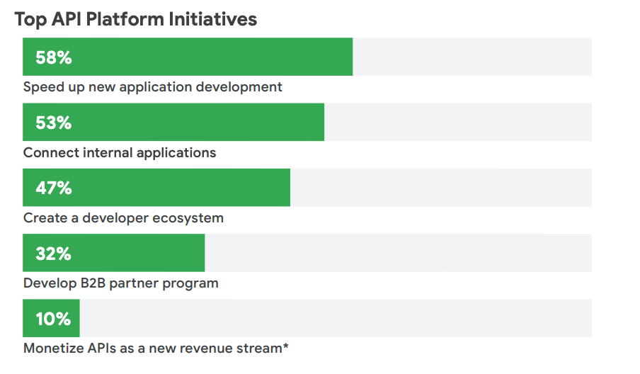
Notes:
https://pages.apigee.com/rs/351-WXY-166/images/Apigee_StateOfAPIS_eBook_2020.pdf

Slide 8
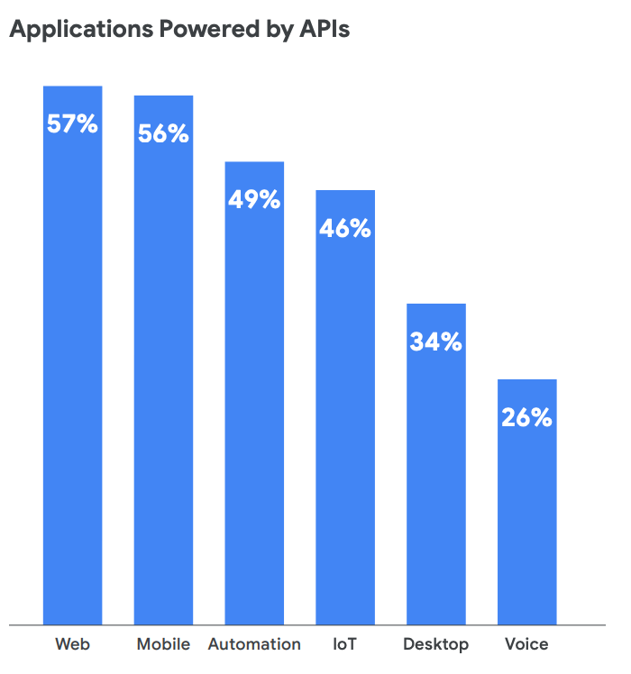
Notes:
https://pages.apigee.com/rs/351-WXY-166/images/Apigee_StateOfAPIS_eBook_2020.pdf

Slide 9
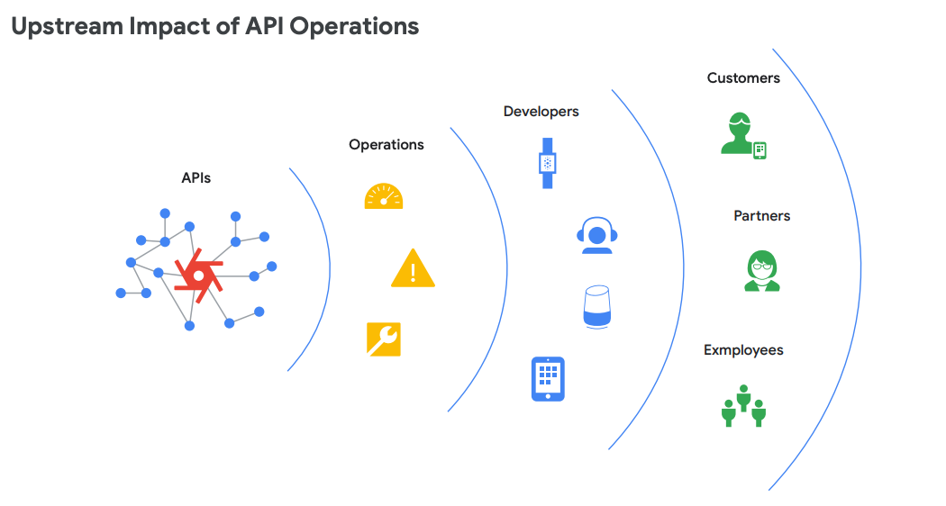
Notes:
https://pages.apigee.com/rs/351-WXY-166/images/Apigee_StateOfAPIS_eBook_2020.pdf

Slide 10
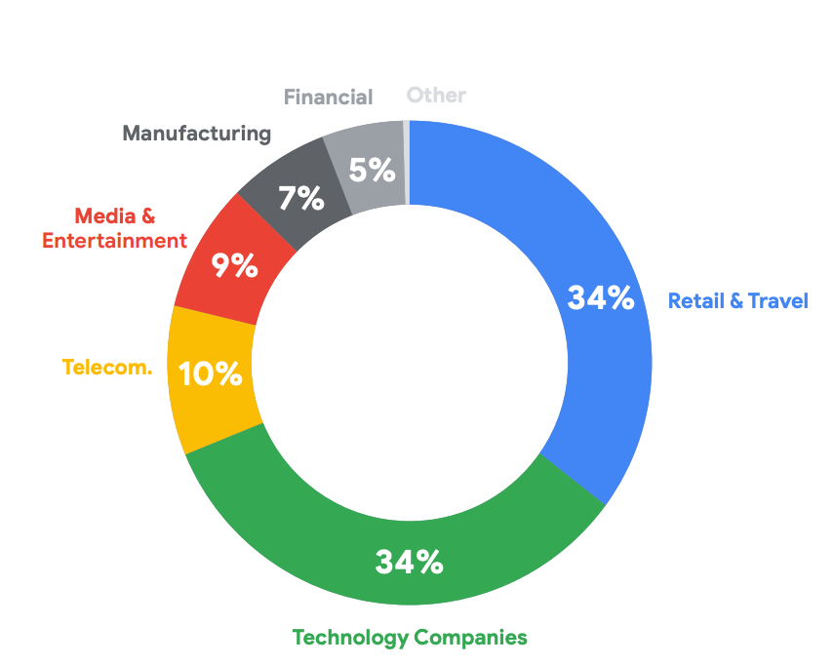
The API Traffic
Notes:
https://pages.apigee.com/rs/351-WXY-166/images/Apigee_StateOfAPIS_eBook_2020.pdf

Slide 11
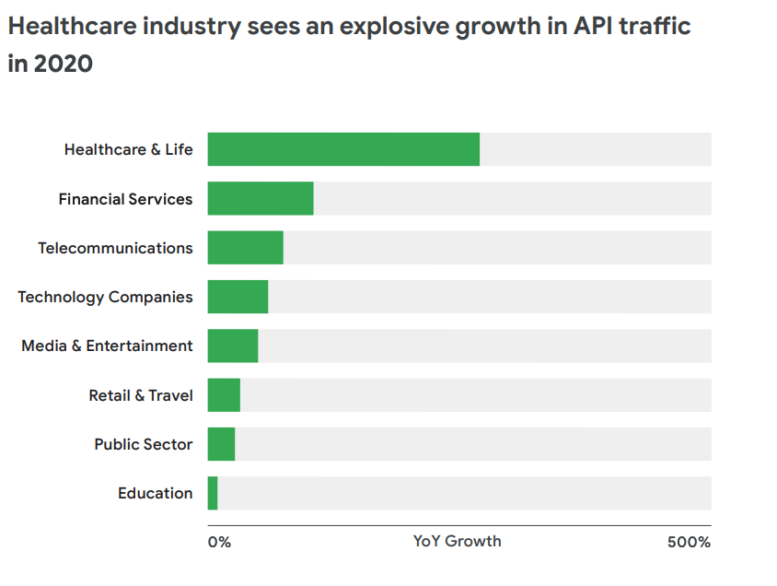
Notes:
https://pages.apigee.com/rs/351-WXY-166/images/Apigee_StateOfAPIS_eBook_2020.pdf

Slide 12
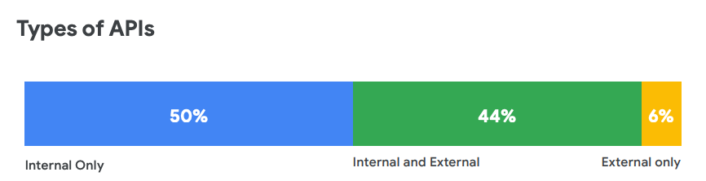
Notes:
https://pages.apigee.com/rs/351-WXY-166/images/Apigee_StateOfAPIS_eBook_2020.pdf

Slide 13
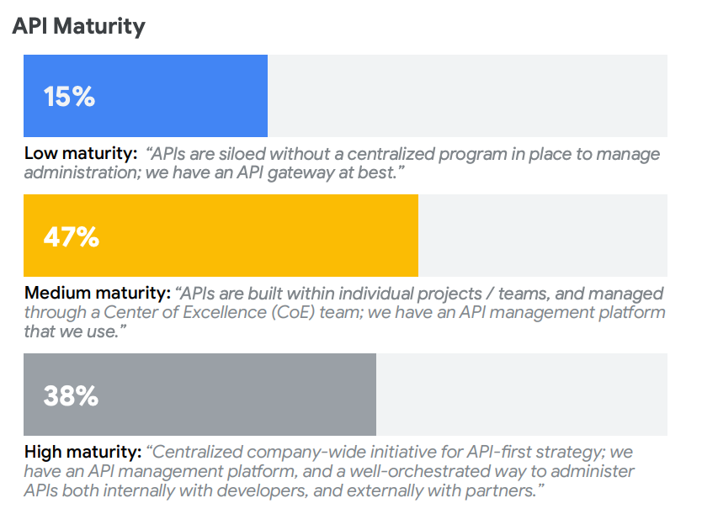
Research indicates higher API maturity tends to correspond with more robust digital transformation efforts. Companies based in the United States, larger companies, and companies within the technology and financial services verticals were most likely to report high API maturity.
Notes:
https://pages.apigee.com/rs/351-WXY-166/images/Apigee_StateOfAPIS_eBook_2020.pdf

Slide 14
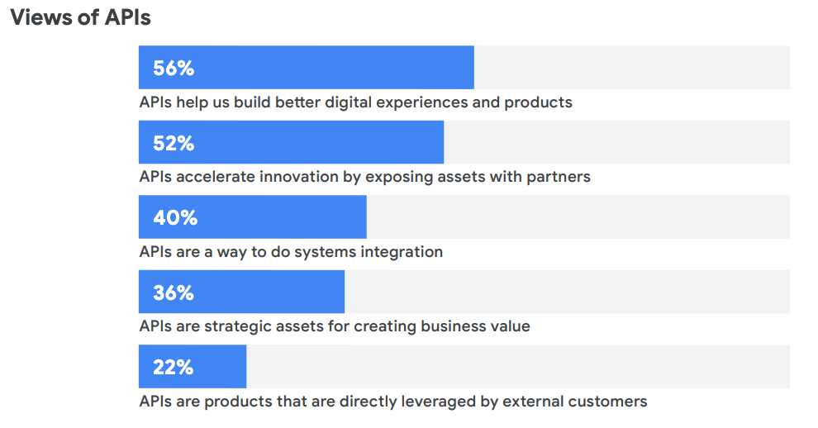
Notes:
https://pages.apigee.com/rs/351-WXY-166/images/Apigee_StateOfAPIS_eBook_2020.pdf

Slide 15
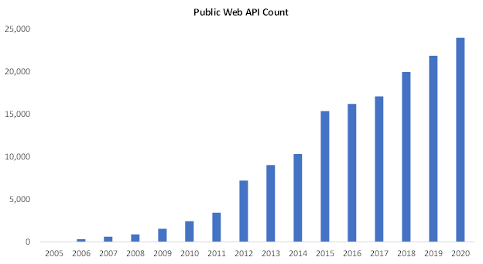
Notes:
https://chrisgaertner.medium.com/the-future-is-api-first-5810584ff23

Slide 16
API as a Product?
If you told developers back in 2005 that they could make money off of an API, they'd laugh at you. The notion that you can build just a layer of software— just one functionality— and sell it as a product seemed insane.
The obvious problem with “selling” an API as a product is marketing. There's no sleek interface to promote and no demo that can show off the bells and whistles. It's essentially an invisible product, whose value is only evident once it's integrated into a platform— something that takes hours, days, or weeks to become familiar with.
Notes:
https://blog.readme.com/on-the-origins-of-api-first-companies/

Slide 17
Why all the Interest in APIs?
One of the most important reasons is the growth in cloud computing, which has led to the need for integration.
APIs enable companies to more easily build products and services that would otherwise take too long to build.
Developers can use APIs to more easily access business-critical information and focus on other priorities instead.
Notes:
https://www.forbes.com/sites/tomtaulli/2020/01/18/api-economy--is-it-the-next-big-thing/?sh=335f53e042ff

Slide 18
What is the API Economy?
The innovative power of APIs has lead to the realization that software as a service (SaaS) applications can be built by combining APIs built by specialized API providers.
That, in turn, has created the API Economy, which empowers developers to specialize and monetize their skills and domain knowledge.
The exchange of these APIs and the systems to manage them is, in a nutshell, the API economy.

Slide 19
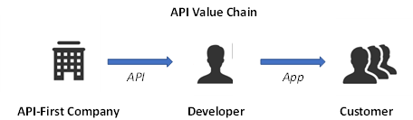

Slide 20
The Exchange of Value is What Makes an API Economy?
In the API economy a developer may have different roles. It may be a Application developer or API provider.
A API provider can also develop on top of other specialized APIs, thus creating layers of APIs.
This creates an API economy where developers charge each other for the APIs built by them. The API provider charges others for using his APIs, and at the same time pays other providers to use their APIs.
The application developers who uses all these APIs bills the end-customer for the service. This exchange of value is what makes an API economy.

Slide 21
Benefits of API Economy
The API Economy levels the playing field for everyone from the smallest developers to the largest companies.
A taxi booking SaaS app, for example, might combine a mapping API, communication API, and billing SaaS API, each from different providers, with their own UX layered on top.
This makes it easy to launch new services without having to build everything from scratch. This makes it easier for all participants to develop unique products, services and functionality quickly and with less cost.

Slide 22
The Effects of the API economy on Businesses
The ultimate goal of the API economy is to facilitate the creation of user-focused apps that support line-of-business goals and improve workforce throughput.
Today's demand for data integration has been encouraging vendors of all sizes to "go modular" and break complex software components down into smaller, containerized components called microservices.
The API economy and the use of microservices make data and services more accessible and flexible.
By building a business model around APIs, businesses can rapidly scale up by using APIs. This can be done by accessing third-party services and data, or using APIs to transform their own data and services into a platform that encourages others to build upon and use it.
Notes:
https://searchapparchitecture.techtarget.com/definition/API-economy

Slide 23
The Importance of the API Economy
APIs simplify access to the information contained in software platforms and their functionality.
They make software platforms and their data easier to integrate.
The API economy is important because it enables businesses to profit off their APIs and create business models around them.
It allows a business to monetize a portion of its data and services, and to turn itself into a platform.
Notes:
https://searchapparchitecture.techtarget.com/definition/API-economy

Slide 24
“The API economy is an enabler for turning a business or organization into a platform” — Gartner

Slide 25
Platform?
In the most general terms, a platform is a group of technologies, solutions, or offerings that form an iterative basis for developing, implementing or deploying other offerings.
A platform is a business model that creates value by facilitating exchanges between two or more interdependent groups, usually consumers and producers. They make software platforms and their data easier to integrate.
In order to make these exchanges happen, platforms harness and create large, scalable networks of users and resources that can be accessed on demand.
Platforms create communities and markets with network effects that allow users to interact and transact.
Panacloud is a Platform for the API Economy.
Notes:
https://nordicapis.com/what-does-it-mean-to-be-a-platform/
https://www.applicoinc.com/blog/what-is-a-platform-business-model/

Slide 26
How do customers benefit from a third-party API vs building internally?
Empower Developers: Leveraging third-party APIs induces innovation. Save time/internal resources by spinning up and testing a new feature in days, not months
Better Customer Experience: APIs reduce friction in the customer experience by making it possible to bring in customer information from different sources.
Cost and Resource Effective: Third-Party Serverless APIs charge on usage, so companies can pay based on the utility received rather than a year-long subscription/number of seats.
Increase Data Visibility: Because of the connected ecosystem these APIs create, businesses get real-time visibility into their customers and how their business is performing, leading to proactive and data-driving decision-making.
Faster Time to Market: With APIs, internal teams don’t need to code functionality from scratch or stitch together multiple applications — they start with integration.
Notes:
https://chrisgaertner.medium.com/the-future-is-api-first-5810584ff23

Slide 27
API-First Approach
The idea is API-as-a-product.
An API-first approach means that for any given development project, your APIs are treated as “first-class citizens.”
APIs allow companies to break down capabilities into individual, autonomous services (aka microservices).
An API-first strategy allows organizations to build APIs that serve all applications, and applications can be developed and maintained efficiently for all devices, platforms, and operating systems.
Notes:
https://nordicapis.com/api-first-companies-the-next-generation/
https://swagger.io/resources/articles/adopting-an-api-first-approach/

Slide 28
The Rise of the API-First Companies
Companies like Stripe, Twilio, and Okta offer APIs as their primary product.
Valued today at over $100+ billion, Stripe is the biggest independent API-first company.
Twilio market cap is $55.97B.
Okta has a market cap of $35.90 B.
Notes:
https://gisford.medium.com/the-third-party-api-economy-part-ii-announcing-the-api-first-directory-2b56a6dedcfa

Slide 29
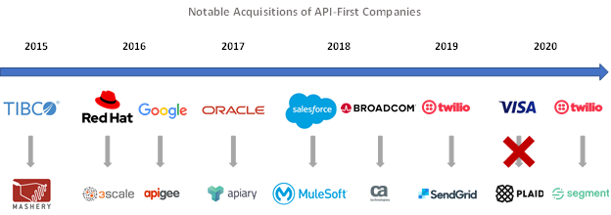
Notes:
https://chrisgaertner.medium.com/the-future-is-api-first-5810584ff23

Slide 30
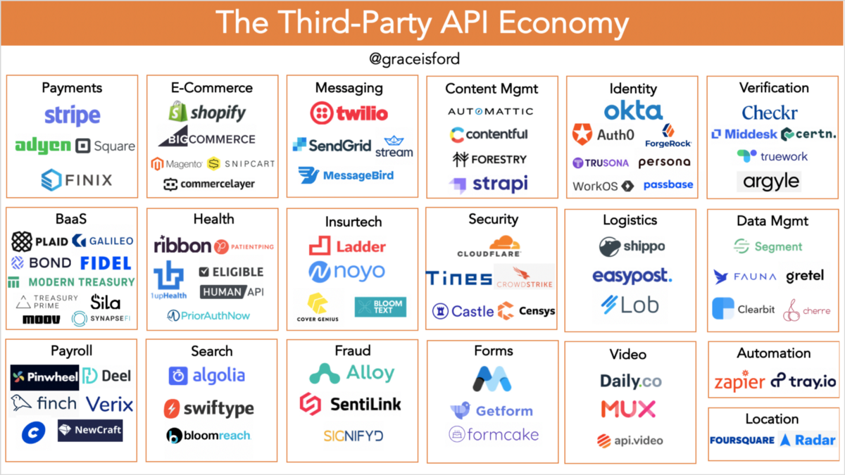

Slide 31
The API Economy Challenges
Often there is no direct contact between the API provider and the developer who utilizes it, it can be hard to know which API to build with what functionality.
It is difficult to know which APIs are available and which API to use and their comparative strengths and weaknesses.
Most of the current SaaS applications and API are built using legacy Cloud 1.0 technologies, thus they don’t have usage based billing support and also some have scalability issues.
The APIs are centrally managed and multi-tenant by their very nature, making it difficult to manage, measure resource usage in a serverless environment, and bill the tenant.
Each and every API provider has to build a custom platform to monitor and measure serverless resource usage and bill clearing functionality thus increasing the time-to-market.
There is an extreme shortage of serverless cloud developers thus making life every difficult for both API providers and SaaS app companies.
There is a scarcity of coherent and comprehensive training material for multi-tenant serverless SaaS app and API developers.

Slide 32
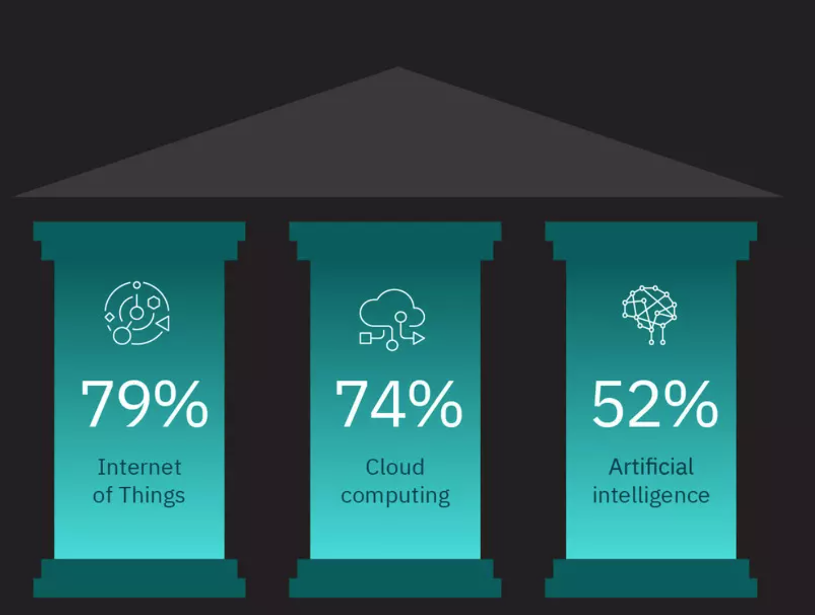
CEO’s look to IoT, Cloud Computing and AI to Deliver Results
Notes:
https://www.weforum.org/agenda/2021/02/the-post-pandemic-future-of-work-according-to-3-000-ceos-from-around-the-world-685436524a/

Slide 33
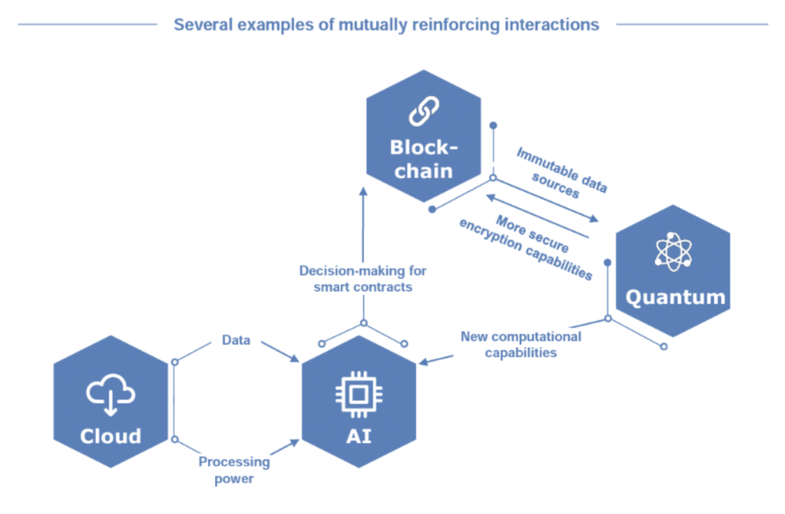
The Interplay between Emerging and Mature Technologies

Slide 34
Where is the link between APIs and Artificial Intelligence
Digitization creates a lot of data.
The APIs will have to leverage artificial intelligence technologies like machine learning algorithms, pattern recognition, decision trees, artificial neural networks, deep learning etc. to make use of this data to build APIs.
Wouldn't it be great to have an AI as a Service available via APIs to which you could talk to in several programming languages to be able to build your own applications?

Slide 35
How APIs can bring AI to life
APIs help train the AI system by enabling access to the right information.
APIs also provide the ability for AI systems to act across the entire customer journey by enabling a communication channel—the nervous system—with the broader application landscape.
By calling appropriate APIs, developers can act on insights provided by the AI system.
Developers can then choose information sources to train the AI models and connect the AI systems into the enterprise’s broader application network to take action.
Notes:
https://www.mulesoft.com/lp/ebook/api/artificial-intelligence-chatbot

Slide 36
AI and ML Used for API Management
Artificial intelligence (AI) and machine learning (ML) are emerging as important ways for organizations to bolster their API management and security capabilities.
AI and ML can help teams predict API behavior, detect anomalies in real time, quickly identify security incidents, precisely diagnose the root cause behind performance and security alerts, and reduce mean time to detect (MTTD) disruptions.

Slide 37
APIs the Bedrock of IoT Development
Before the IoT can reach its potential, businesses must identify a way to connect a range of devices and sensors with enterprises’ backend systems.
Gartner estimating that half the cost of implementing IoT will be driven by integration.
The most effective way to overcome these challenges is to deploy IoT in a modular fashion, with a flexible integration layer between devices, data, and the overall IT ecosystem. This can best be achieved using APIs.
Notes:
https://www.mulesoft.com/lp/ebook/api/artificial-intelligence-chatbot

Slide 38
Connecting the Layers of IoT using APIs
Successful IoT deployments consist of layers, including the devices that collect the data, the networks that deliver the data, and the applications that analyze and make sense of that data.
While they need to work together as an integrated whole, it’s important that organizations future-proof their businesses by making the components modular using APIs.
Underpinned by APIs, IoT systems enable applications, data, and devices to be plugged in and out seamlessly without negative knock-on effects.
Another benefit with taking an API-led approach is that security is built in by design, as IT teams can regulate and enforce who has access to what data.
Notes:
https://www.mulesoft.com/lp/ebook/api/artificial-intelligence-chatbot

Slide 39
How important is the API economy for blockchain application development?
Imagine a gaming contract on Ethereum written in Solidity. The gaming contract chooses a winner who receives a sum of $ 100 in Bitcoin.
Your application first needs the API to detect who has won the raffle.
Then you need to send the payment via the Bitcoin network and monitor if the transaction is completed.
All these actions can be provided by a single API .
Therefore, it is fair to say that APIs data are a crucial part to create more applications with blockchain technology.
These APIs provide the ability for any product to implement blockchain payments or any other smart contract functionality through an API.
In short, blockchain APIs definitely lower the barrier for the implementation of blockchain functionality as an API is a well-known technology.
Notes:
https://www.hebergementwebs.com/blockchain/how-important-is-the-api-economy-to-blockchain-application-development

Slide 40
Band Oracles: Connect smart contracts with any API
Blockchains are great at immutable storage and deterministic, verifiable computations. However, they cannot access trusted real-world information available outside their networks.
Band Protocol is a cross-chain data oracle platform that aggregates and connects real-world data and APIs to smart contracts.
Band Protocol enhances smart contract functionalities by granting them access to reliable data without any central points of failure.
Band Protocol's flexible oracle design allows developers to use any data including real-world events, sports, weather, random numbers and more.
Developers can create custom-made oracles using WebAssembly to connect smart contracts with traditional web APIs within minutes.
Notes:
https://bandprotocol.com/

Slide 41
Serverless APIs
Ideally, the developer who uses APIs wants to be charged a usage based subscription fee, not a fixed monthly subscription.
This usage based subscription fee has been made possible by serverless cloud technologies.
Serverless is also being called Cloud 2.0.

Slide 42
Standards for API Definition
For REST APIs, OpenAPI, has emerged as the winner.
While REST is popularly regarded as the standard way to design APIs, GraphQL is increasingly touted as a revolutionary technology capable of trumping REST's weaknesses.
These two formats has resulted in more standardization and better tooling for developing and managing APIs.
Notes:
https://api-university.com/blog/architectural-style-for-apis/
https://www.openapis.org/

Slide 43
What's in it for us
We can find a gap in an existing system or can find a real world problem which has not yet been automated. And develop a platform for that with API first approach.
E.g if there is a popular online store where there are multiple retailers, a product comparision or price comparison API can create a difference.
Notes:
https://api-university.com/blog/architectural-style-for-apis/
https://www.openapis.org/

Slide 45
Serverless API
D3 Consideration
Design Consideration
Scalling Needs
Availability Needs
Performance Needs
Development Consideration
Local PC (own Laptop)
Hardware, software and availability
Cloud IDE/Notebooks vs over ssh development
Hardware Consideration
Always-on Vs On Demand
Pay as use vs Spend once
Scale in Start vs Scale as we need
Deployments Consideration
On-demand, frequently :aws Lambda Function
Always on: Scalable end-points
infrequently needs: SageMaker Containers
Monitoring Deployments: Cloud API
Let’s Apply

Slide 46
Serverless API
Examples Implementation
Computational Intensive Processing
Not always needed: Low availability needs
Heavy Hardware and
Complex software Setup
Frequent scaling in hardware
Regular updates in software
Less Frequent execution
Containerized API like SageMaker
Controlling and Monitoring API

Slide 47
Serverless API
Examples Implementation
Light Weight Processing
Frequently needed, some time more some time less
Low Hardware requirement
Less Software configuration changes
Code Change are easy
AWS Lamda Functions
Alert and Monitoring API

Slide 48
Serverless API
Examples Implementation
High User Interaction: Low processing
User Load could be low at a time and high next time.
High response time needed
Always availability required
Scalable Endpoints that consume other API

Slide 49
Serverless API
Examples Implementation
What if an Application Needs all discussed Scenario :
Heavy processing some time
frequency processing most of the time
User Interaction all the time
It's a Monolithic Pattern, Need to break in interconnected API/MicroServices

Slide 50

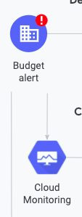

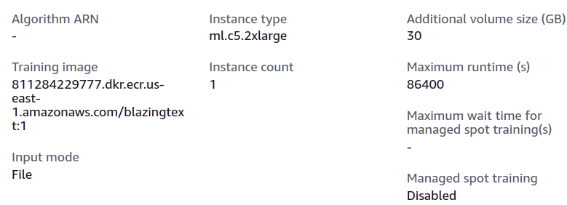
Serverless API
Examples Implementation
Light Data Processing Service
Heavy Data Processing Service (when called will use cloud infrastructure
API
API
Other External APIs
User Interaction Service
API
5 minutes Training job on a heavy server

Slide 51
Serverless API Working Assignment
Panacloud is working on a Web channel (Panacloud.tv) that stream videos and provide online support to its bootcamp students. You are required to design a high level architecture of the application with proper distribution of the its enterprise application into manageable services and choose a best fit cloud infrastructure. You can choose any previously discussed option from cloud (aws specific) with following consideration
Among designed services you need to choose that each service would have API , UI, CLI or any combination .
Each service would require heavy duty, lightweight or any combination ?
Which type of infrastructure would require
Security and Complience
Videos ML Training
Some Example Functions of Panacloud.tv
Data Pre processing
Inference/Prediction
Team managment
Financials
Product/Program management
Resource Aquisition and control

Slide 52

Thank You
Platform for the API Economy
Fusing Serverless, AI, IoT, Blockchain, and Quantum Technologies
in Next-Gen APIs

Slide 53
Next Week
Content for Week 2

